Slide 1
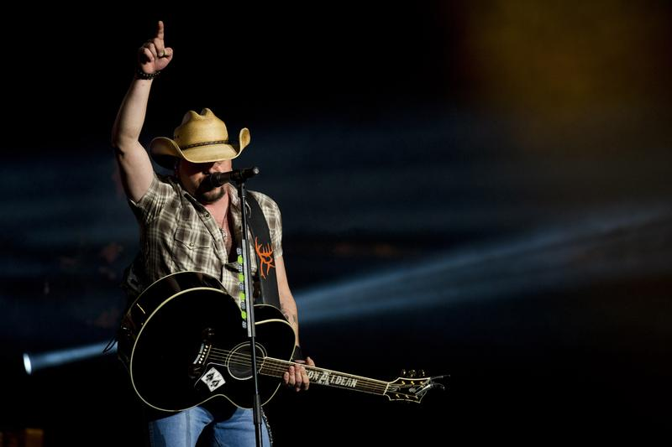

Generating Country Song Lyrics using Long Short-Term Memory Networks

Slide 2
Why Country music?
Musical Genre that has trouble keeping up with today’s fast-paced Streaming Services (“only 5.6 % of Spotify’s total streams”)
Recurring themes in Country Music Lyrics (Nostalgia, Beer, Religion, Patriotism, Trucks etc.)

Slide 3
Structure of this presentation
1) State of the Art
2) Review of RNNs and LSTMs
3) Overview and Processing of the Data Set
4) Training/Testing with different amounts of data and number of epochs
5) Conclusion/what to improve

Slide 4
1) State of the art

Slide 5
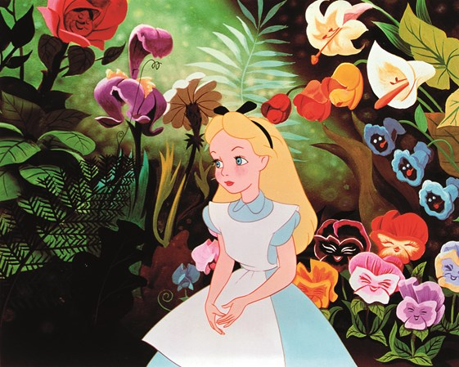
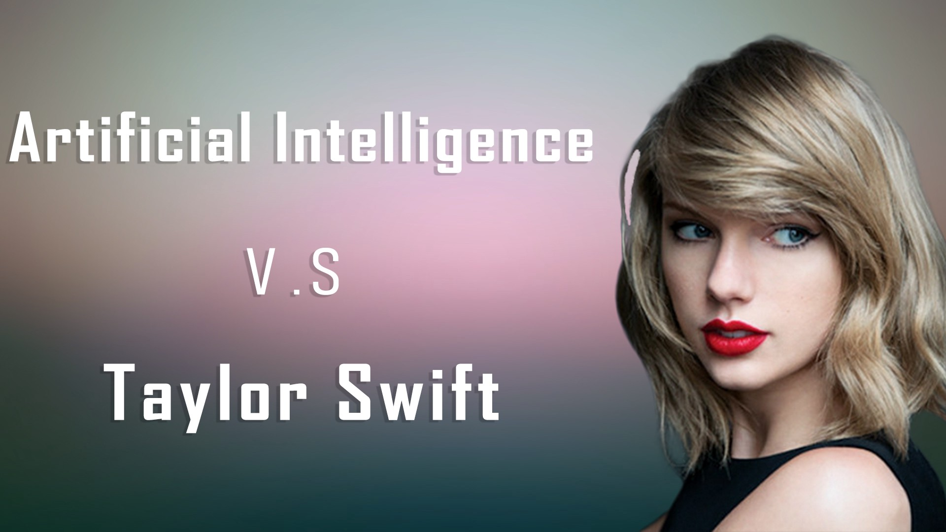
LSTM’s for text generation
LSTM’s are widely used for text generation. Notable examples include:
“Alice in Wonderland” (novel by Lewis Carroll) text generator
Taylor Swift Lyrics Generator

Slide 6
2) Review of RNNs and LSTMs

Slide 7
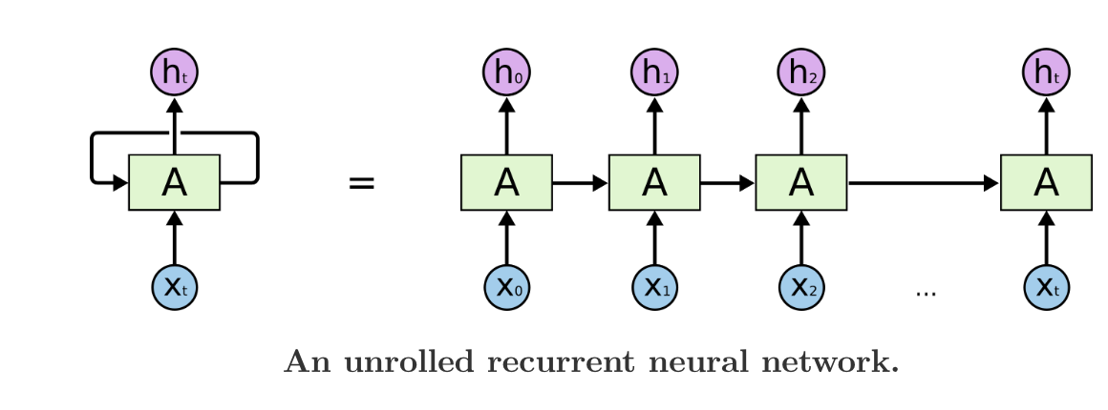
Recurrent Neural Networks
”A recurrent neural network is a neural network that is specialized for processing a sequence of values x⁽¹⁾,…, x^{(T)}
Long-term dependency problem: “I grew up in France,…….. I speak French fluently.” As the distance grows between the relevant information and the predicted word, RNN’s go down in accuracy

Slide 8
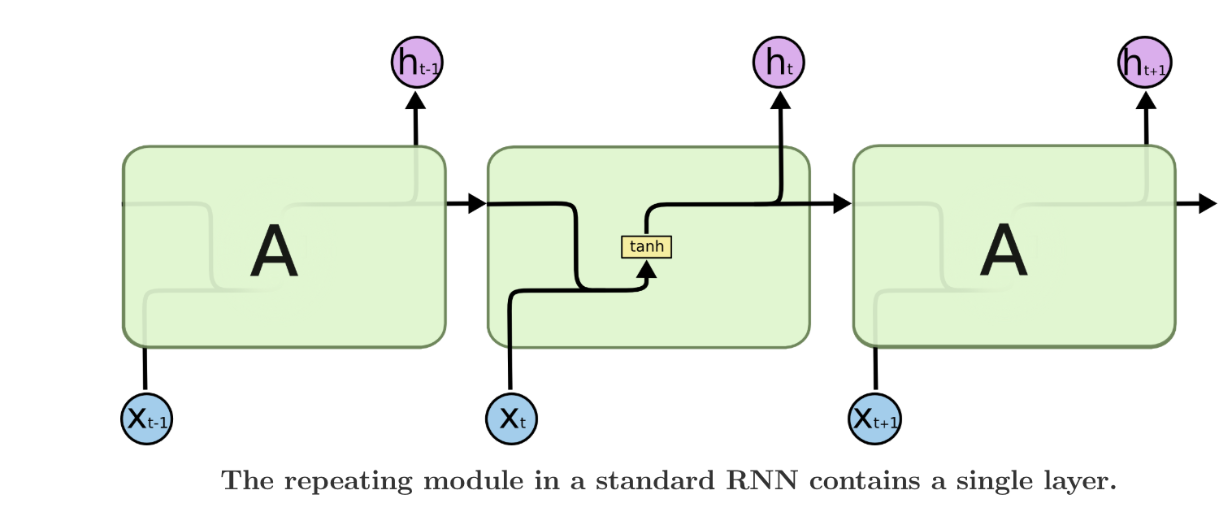
Classic RNN

Slide 9
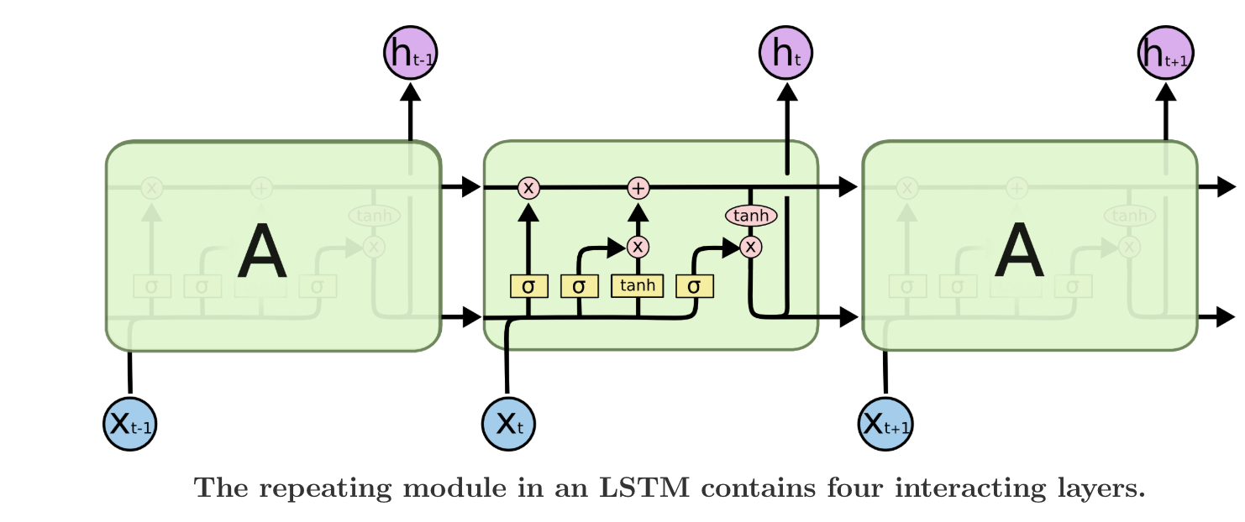
Long Short Term Memory RNN’s
Long Short Term Memory networks (LSTMs) are better at learning long-term dependencies
Instead of having a single neural network layer, there are four

Slide 10
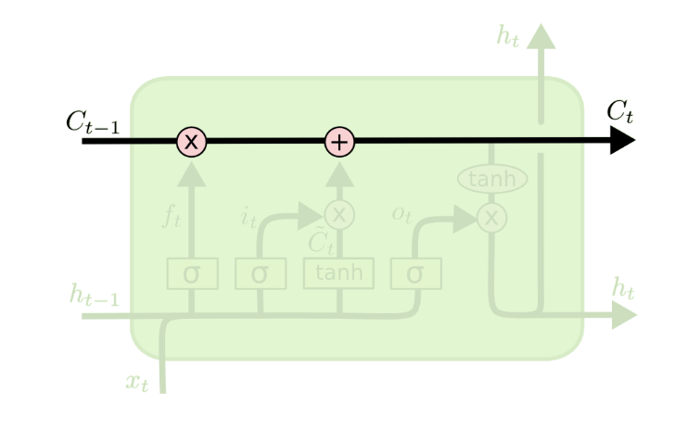
Long Short Term Memory RNN’s – Cell State
Cell State: a “conveyor belt” to which information is added through “gates”, which are each composed of activation functions such as tanh or sigmoid, as well as pointwise operations. These gates regulate the flow of information of the cell state.

Slide 11
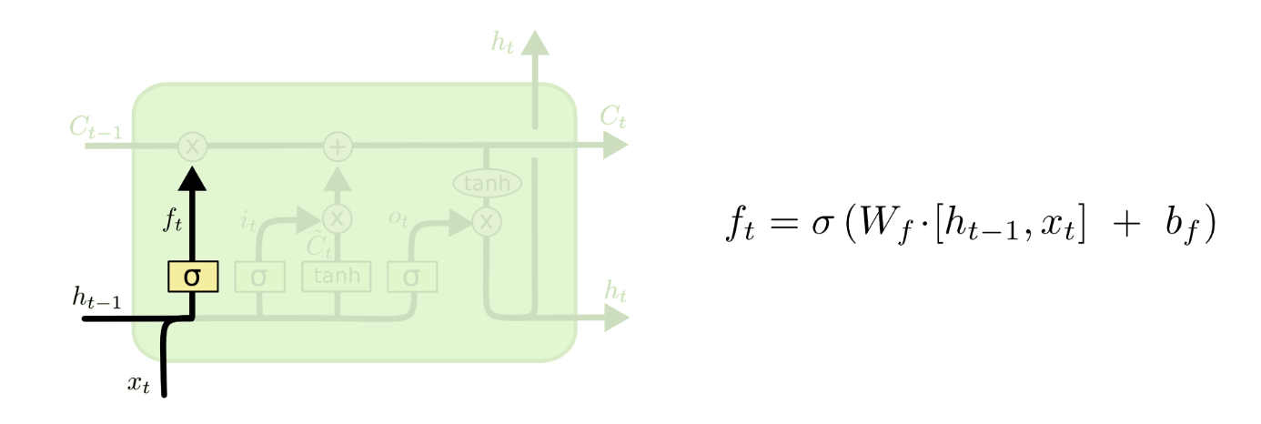
Long Short Term Memory RNN’s - Gates
Forget Gate: decides how much information is kept from the previous cell state. The sigmoid function outputs a number between 0 (completely get rid) and 1 (completely keep)

Slide 12
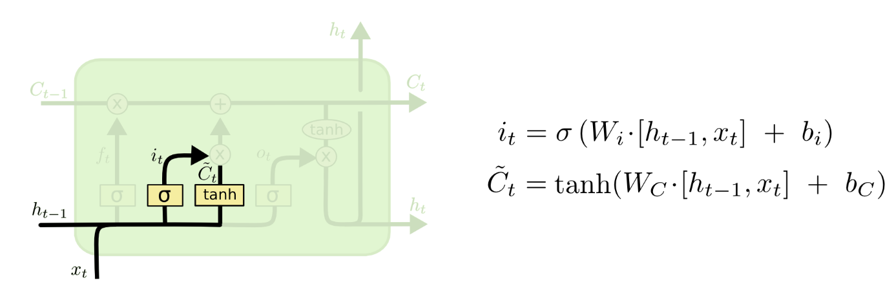
Long Short Term Memory RNN’s - Gates
Input Gate: decides which values are updated (i_{t}) and creates a vector of new candidate values (C̃_{t}).
I_{t} and C̃_{t} are combined using pointwise multiplication and added to the cell state

Slide 13
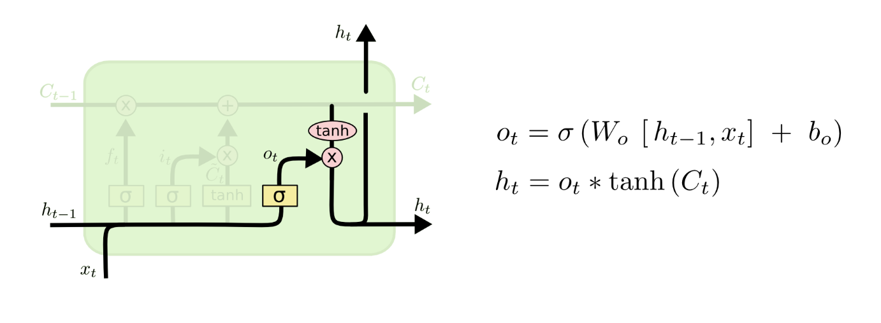
Long Short Term Memory RNN’s - Gates
The output is a filtered version of the cell state.
Output gate: Uses a sigmoid function to decide which parts of the cell state will be output (o_{t}). We also pass the cell state (C_{t}) through a tanh function. We then use pointwise multiplication (h_{t}).

Slide 14
3) Overview and Processing of the Data Set

Slide 15
The Data Set – Initial Pre-processing
CSV file found on Kaggle: “380,000+ lyrics from MetroLyrics”, each song classified with their “index”, “song name”, ”year”, “artist” “genre”
Downloaded it as a Pandas Dataframe and only selected the rows where the genre was “country”.
Deleted the “index”, ”year”, “artist” and “genre” columns to only keep the song names and lyrics. Also deleted the rows that had NaNs. The resulting Dataframe had 2 columns and 14387 rows
Converted the “lyrics” column content to a lower text .txt file.

Slide 16
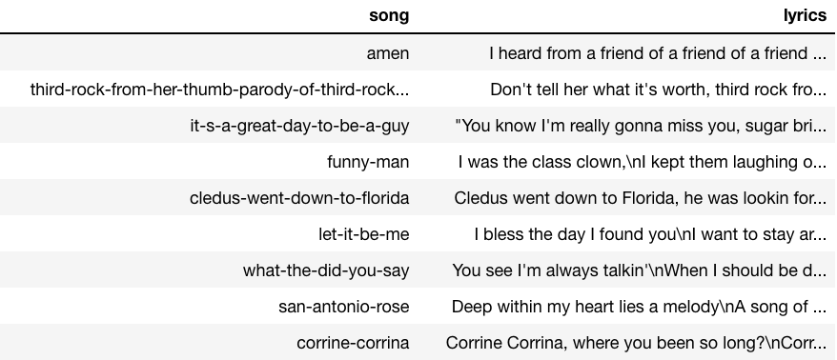
The Data Set – Initial Pre-processing
Dataframe after initial pre-processing

Slide 17
The Data Set – Lyrics
Counted the total number of characters: 13250494
Each character is then mapped to an integer using a python dictionary (with a vocabulary of 115 different characters)
Different characters in our Data Set

Slide 18
The Data Set – Lyrics
Split the data into input X (sequence of 100 characters) and corresponding output y (following 1 character). X was therefore a 13250394 x 100 matrix
y was a 13250394 x 1 matrix that was one-hot encoded. The new y was therefore a 13250394 x 115 matrix.
Split the data into 80% training and 20% testing

Slide 19
4) Training/Testing with different amounts of data and number of epochs

Slide 20

Description of the LSTM used
LSTM built using the Keras Sequential Model (trained using Keras fit function)
4 layers
256 nodes in each layer
For the first layer, we specify the input shape as a 100 x 1 argument
We then add 3 hidden layers and flatten the data before passing it through a softmax function
calculate the cross-entropy loss and use adam optimizer (default parameters for Keras are: α = 0.001, β₁ = 0.9, β₂ = 0.999 and Ɛ = 10−8)

Slide 21
Compromising Computational Time vs. Accuracy
CPU’s are extremely slow, especially for text generating
For the whole data set (14 387 songs, 13 250 494 total characters, 115 different characters, 4 784 243 parameters) each epoch would take approximately 50 hours.
For 100 songs (87 978 characters, 61 different characters, 3 401 789 parameters) each epoch would take approximately 16 minutes.
For 10 songs (10 106 characters, 39 different characters, 2 838 567 parameters), each epoch would take approximately 2-3 minutes.

Slide 22
TESTING
Input 100 characters (“Seed:”) and generate 300 new ones character by character using a for loop (using the predict Keras function)
The input is updated at each iteration as we take the last 100 characters (sliding)

Slide 23
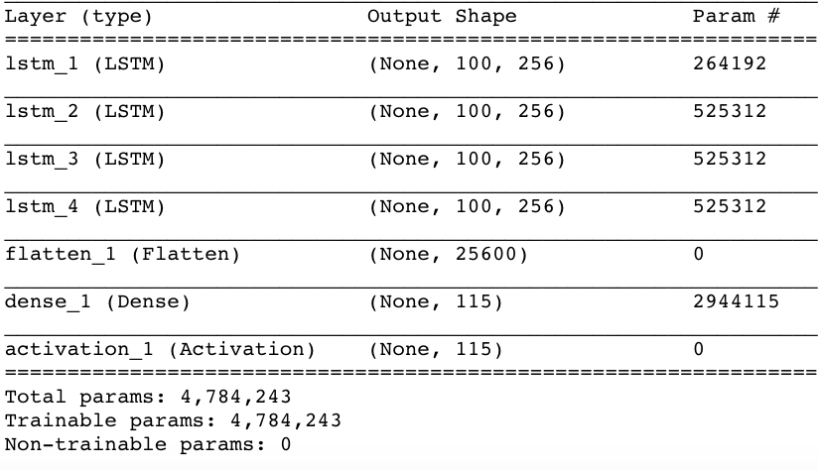
Summary of the LSTM for full Data Set

Slide 24
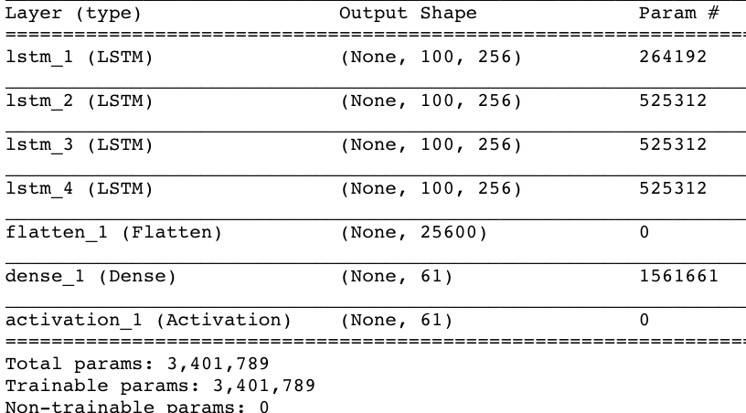
Summary of the LSTM for 100 songs

Slide 25
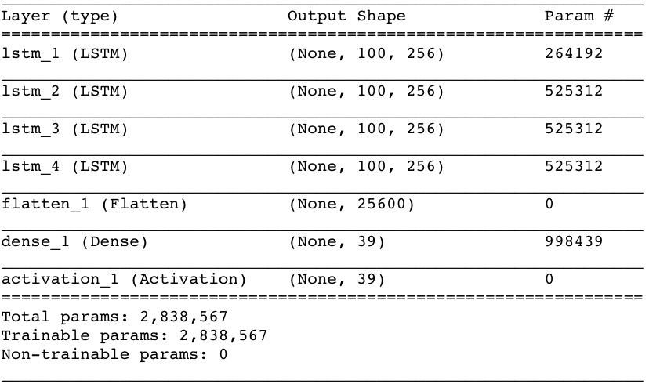
Summary of the LSTM for 10 songs

Slide 26
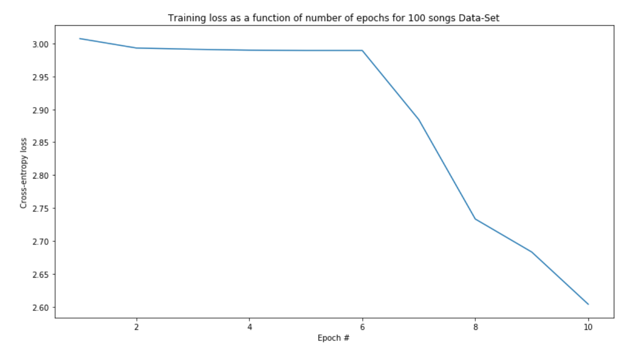
Training – with 100 songs (10 epochs, batchsize of 128)

Slide 27
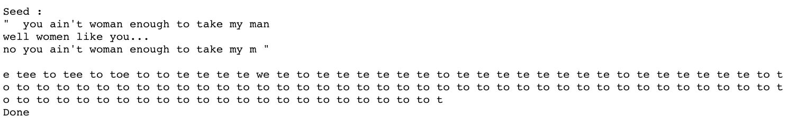
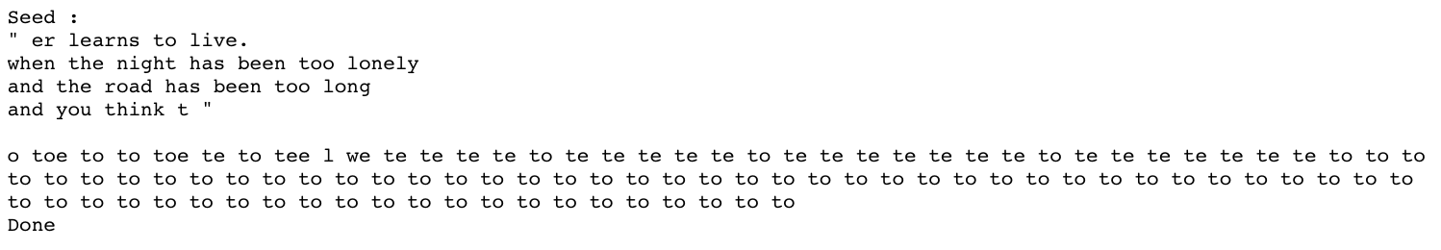
Testing – with 100 songs
For 100 songs and 10 epochs, the model generated
or

Slide 28
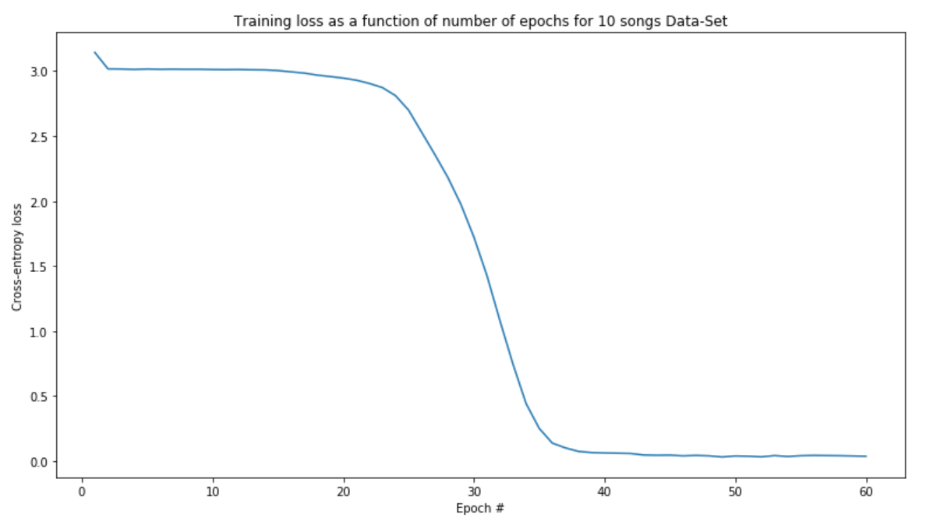
Training – with 10 songs (60 epochs, batchsize of 128)

Slide 29
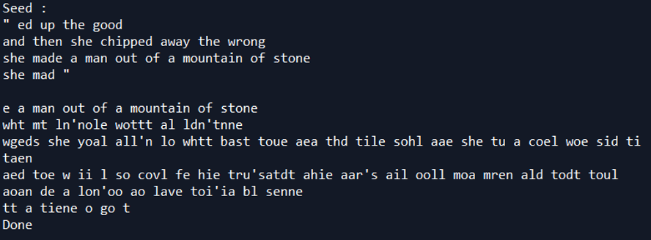
Testing – with 10 songs
Take a random sequence of 100 characters and predict the next 300 characters.
For 10 songs and 10 epochs, the model only generated spaces
For 10 songs and 30 epochs, the model generated

Slide 30
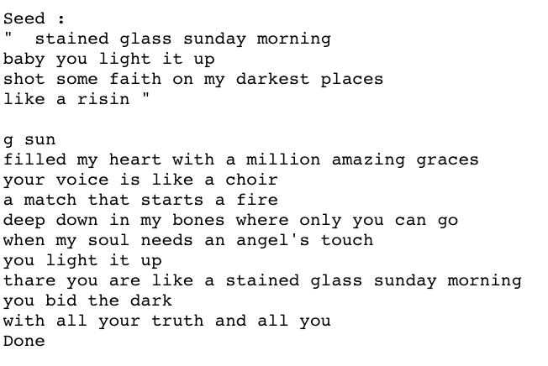
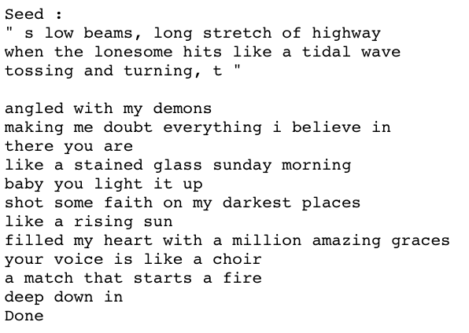
Testing – with 10 songs
For 10 songs and 60 epochs, the model had great results

Slide 31
5) Conclusion/what to improve

Slide 32
Conclusion and what to improve
LSTMs and RNNs are made to be trained on GPUs and not CPUs. Try again using cloud computing services such as AWS to vary parameters and train for more songs (maybe try with a batch size ~16, maybe a better chance of escaping a local minima, reduce number of layers, add a dropout)
Number of epochs is more important than data size for text generation.
However, with few songs, the LSTM only reproduces the exact song and does not generate original lyrics.

Slide 33
References
https://www.westword.com/music/the-ten-biggest-tropes-in-country-music-5694846
https://www.billboard.com/articles/business/7941122/country-music-streaming-digitalera
https://towardsdatascience.com/ai-generates-taylor-swifts-song-lyrics-6fd92a03ef7e
http://colah.github.io/posts/2015-08-Understanding-LSTMs/

